Slide 1
Agile project Management
By: latisha m. Burnham
June 2023

Slide 2
history
Developed by Ken Schwaber and Jeff Sutherland in the late 1990s.
Agile was created to provide quick and efficient production of customer products through incremental development centered around continuous communication.
Agile is an adaptive approach to project management that focuses on the idea the ability to adjust and change as the project develops. Agile understands that not all projects start well defined and planned in the beginning.
Agile practices the values and principles laid out in the Agile Manifesto created in 2001.

Slide 3

Agile manifesto
The Agile Manifesto lays out the values behind Agile. In their statements, the items on the left and right of the statements have value. However, more value should be placed onto the items on the left.
Individuals and interactions over processes and tools
Working software over comprehensive documentation
Customer collaboration over contract negotiation
Responding to change over following the plan
(Agile Manifesto, 2001)

Slide 4

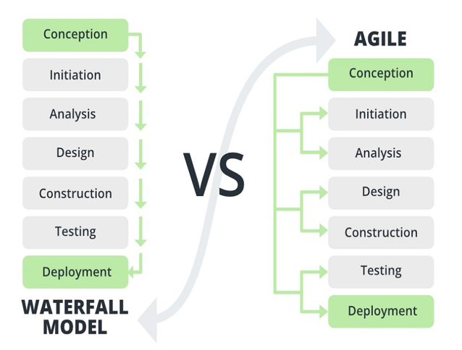
AGILE VS WATERFALL
Agile allots for change during the development process unlike waterfall.
Agile requires teams to communicate during and after the development process.
Agile involves the client in the development process to ensure that the client is always aware of the projects status. This ensures that the client is satisfied with the products end result versus waiting until the end to see the outcome.
Waterfall flows a linear structure that only allows the team to move forward in the stages of development and planning. This leaves no room for changes since they are unable to go back in the model.
(Agile vs Waterfall Project Management, 2022)

Slide 5

SDLC- AGILE Methodology
Stages of the Agile SDLC:
Planning/Vision: The Product Owner meets with client and stakeholders to discuss the projects details.
Defining/User Stories/Sprint Backlog: The Product Owner and Scrum Master plan the sprints using the product backlog and user stories to the lay out the requirements. The team decides on how much they can complete during the sprint and organizes the scrum board accordingly.
Development: The development team and the Scrum Master work through the user stories to develop a ”done” product before sending to testing.
Testing: Test the development teams and check for bugs or potentially crashes.
Deployment: Product is released to the public.
This process is repeated in sprints that last anywhere from 2 to 4 weeks. This allows for flexibility and openness to product changes.

Slide 6



Scrum Approach
SCRUM ROLES
Product Owner
Scrum Master
Most used agile methodology.
Scrum is adaptive in its ability to define the requirements of the project during development. It’s flexible to change due to its short (2 to 4 week) sprints.
After each sprint, the team reflects on how they felt the sprint went and where they can make improvements.
Development Team

Slide 7

Scrum Roles
Product Owner
Scrum Master
Liaison between the client and the Scrum Team.
Creates and maintains the product backlog. The product backlog lists all the requirements for the project based on the client's requests.
Prioritizes work based on the product backlog to ensure that the desired outcomes are met in a timely manner.
Responsible for the products outcome.
Gathers feedback from the team and the client at the end of each sprint to help optimize the team and prepare for the next sprint.
During the development of the SNHU Travel Application, the Product Owner helped make sure that the client goals were being meet during the development process. They communicated with the client through the entire process and informed the development team of the changes that needed to be made during the sprint.
Works alongside the Product Owner and Scrum team.
Communicates on behalf of the development team to ensure they have no distractions during the sprint.
Removes barriers that may impede on the team's progress.
Creates and maintains the Scrum Events .
Ensures that the team practice Scrum Theory and work on their daily tasks to meet deadline.
Scrum Masters do not control the team but instead helps them improve and remain focused on becoming self-organized.
During the development of the SNHU Travel application, the Scrum Master helped manage the daily scrum meetings and scrum board. They helped to ensure that the team was working efficiently and remained on task. The Scrum Master helped ensure that the team communicated during the development process for transparency.

Slide 8



Scrum Roles- Development Team
Developer
Tester
Creates the clients end-product using the product backlog and scrum board as guidance.
Team tends to be small and follow the “Two Pizza Rule”. The “Two Pizza Rule” was created to explain that the size of a team should only be large enough to eat two pizzas.
Manages the programming and testing of the product.
Attend scrum meetings and events to ensure they are current on the project's goals and tasks.
Works with the testing team to create a “done” product.
During the SNHU Travel project, the development team was able to utilize the user stories to complete the requirements of the project. They were flexible to the changes made mid-production. They participated in the daily meetings to stay connected and updated with one another.
Part of the development team
Creates testing criteria based on user stories.
Checks for any flows in development that could lead to bugs and/or crashes.
Implements different types of testing:
Automated regression testing
Value-driven and risk-based testing
Acceptance test-driven development
During the SNHU Travel project, they ensured that the programs operated as requested before completion. They reached out the Product Owner when testing criteria was unsure. Having testers ensures that the program works and any bugs are resolved quickly.

Slide 9

Why agile over waterfall?
During the development of the SNHU Travel project, using Agile allowed for the team to remain open to last minute changes.
Waterfall is plan-driven and only works when the projects plan is laid out fully in the beginning. Agile is an adaptive approach to project management. Agile understands that the project’s requirements may change during development.
Clients are more involved in the projects planning when using Agile. The customer input is valued throughout the process so that they are aware of the projects status at the end of each sprint.
Agile aids in ensuring the client receives a product that they approve of without being blindsided in the end.
Agile can help save costs but reducing bottlenecks in the project that could result in more man hours. It also helps minimize the projects overall production time.

Slide 10
References
Agile vs Waterfall Project Management. (2022, April 6). GeeksforGeeks. https://www.geeksforgeeks.org/agile-vs-waterfall-project-management/
Agile Manifesto. (2001). Manifesto for Agile Software Development. Agilemanifesto.org. https://agilemanifesto.org/

